Slide 1

Taste of Home
Student Details
Guide Details
Ms. Sowmya BP,
Assistant Professor
Department of Computer Applications
Name : Gandhi Nisarg Ketan
SRN : PES1PG22CA070

Slide 2
Abstract
Taste of Home is a MERN Stack Web marketplace connecting local food producers with consumers, empowering home cooks to offer their specialties.
Key features include user profiles, detailed listings of items, messaging, rating system and secure payment system.
The platform aims to reduce food waste and contribute to local economies, redefining the digital experience of sharing homemade delights.
Semester III
UQ21CA761B Project Work Phase II
Notes:
Intro
Key features
Aims – reduce food waste and contribute to local economies since it supply on demand model

Slide 3
Problem Definition
Problem Scenario
Limited Connectivity : Challenge in efficiently connecting local food producers with potential consumers.
Underutilized Culinary Talents : Local producers face difficulties in showcasing and promoting their unique specialties.
Food Waste in Traditional Supply Chains : Existing food supply chains contribute to food waste, lacking a streamlined approach for demand and supply matching.
Semester III
UQ21CA761B Project Work Phase II
Notes:
limited connectivity
Underutilized culinary talents
Food waste in traditional supply chain

Slide 4
Proposed Solution
Digital Bridge & Connectivity: Comprehensive digital platform serving as a bridge between local food producers and consumers.
Supply-on-Demand Model: Introduces a supply-on-demand model, allowing producers to meet consumer demand more efficiently.
Proposed Solution
Proposed Solution
Notes:
Digital bridge and connectivity
Supply on demand model

Slide 5
Project Purpose
Promotion of Culinary Talents : Provide a platform for local culinary talents to showcase their specialties, celebrating the diversity and authenticity of homemade food.
Address Critical Issues : Contribute to reducing food waste and improving food security by encouraging a sustainable and localized food supply chain.
Semester III
UQ21CA761B Project Work Phase II

Slide 6
Project Scope
Create a thriving ecosystem for celebrating and promoting local culinary talents.
Address critical issues like food waste and support local economies.
Semester III
UQ21CA761B Project Work Phase II
Notes:
Ecosystem and promoting local culinary talents
And address critical issues

Slide 7
Domain Survey
Local Food Supply Chain Platforms:
Survey existing platforms that aim to connect local food producers with consumers.
Analyze features, user interactions, and shortcomings of these platforms.
Identify successful strategies for promoting local culinary talents and reducing food waste.
Community – Driven Food Initatives:
Explore community-driven food initiatives that support local economies and sustainable practices.
Assess how these initiatives foster direct connections between producers and consumers.
Extract insights on community engagement, user satisfaction, and impact on local food systems.
Semester III
UQ21CA761B Project Work Phase II
Notes:
survey

Slide 8
\
Literature Survey:
Title: A Real Time Web Service System for Food Delivery
Authors: Kartik, Ishika Bansal, Kirti, Kartik Rajvanshi
Date: 2023
Publisher: Journal of Data Acquisition and Processing
Summary:
The research paper focuses on developing a real-time web service system for food delivery to provide fresh, hygienic, and affordable meals to customers living away from home.
The paper discusses the need for nutritious and healthy food options for individuals studying or working outside their homes and the challenges they face in obtaining such meals.
The authors propose a web service that aims to offer quality food, reasonable prices, and a variety of tastes while also providing employment opportunities for housewives. The system includes features such as database design, user interface, payment methods, order tracking, and process diagrams.
Semester III
UQ21CA761B Project Work Phase II
Notes:
Food delivery
Need of nutritious and healthy food options
Purpose – web service that aims to offer quality food at reasonable price
System include – database design,user interface, payment methods,order tracking,process diagram

Slide 9
Literature Survey:
Title :- Food Ordering website "Cooked with care" developed using MERN stack
Author :- Amit Shersingh Chauhan, Abhishek Mishra, Sushil Bhardwaj, Sunita Nandgave
Date: 2022
Publisher: IEEE Xplore
Summary:
The research paper presents the development of a food ordering website called "Cooked with care" using the MERN stack (MongoDB, ExpressJS, React, NodeJS) and other technologies such as AWS cloud storage.
The website aims to provide a digital platform for homemakers and restaurant owners to sell their products and services online, with customer feedback and the ability to update menus.
The paper discusses the design and implementation of the website, its features including customer payment gateway, order management, and generating bills and invoices, and highlights its potential to reduce food wastage and enhance convenience for consumers and business owners.
Semester III
UQ21CA761B Project Work Phase II
Notes:
Food ordering website using mern stack
Digital platform for home makers and restaurant owners
Design and implementation of website
Customer payment gateway,order management and generating biilss and invoice

Slide 10
Literature Survey:
Title: Web Based Application for Ordering Food Raw Materials
Authors: Rita Layona, Budi Yulianto, Yovita Tunardi
Date: 2021
Publisher: 1st International Conference on Computer Science and Artificial Intelligence
Summary:
The research paper addresses the economic impact of the Covid-19 pandemic in Indonesia, specifically focusing on the challenges faced by housewives in shopping for food raw materials while avoiding virus transmission.
The authors propose a web-based application that allows housewives and community members to safely and easily order food raw materials from local merchants, with delivery carried out by a local government courier.
The study utilizes a mixed method approach, combining quantitative research and the Waterfall development method, to gather requirements and develop the application. The paper highlights the importance of centralized goods delivery and the use of Indonesian language for local residents.
Semester III
UQ21CA761B Project Work Phase II

Slide 11
Literature Survey:
Title: Causal analysis of factors contributing to food wastage in restaurants of India
Authors: Mahakpreet Kaur Virdi, Shubhangi Gupta, Nitasha Hasteer, Kashish Rastogi
Date: 2023-12-27
Publisher: International Conference on Computational Intelligence and Sustainable Engineering Solutions (CISES)
Summary:
The research paper investigates the factors contributing to food wastage in restaurants in India.
The study uses a survey analysis to identify six factors causing food wastage and applies the DEMATEL (Decision-Making Trial and Evaluation Laboratory) approach to establish causal relationships.
The most influential factor identified is "Less Shelf Life (LSL)." The paper emphasizes the importance of reducing food waste for social, economic, and environmental reasons.
Semester III
UQ21CA761B Project Work Phase II

Slide 12
Literature Survey:
Title: Design of Web App for Online Food Services
Authors: Harsh Pathak, Naman Gupta, Dhiren Premakar, Preeti Garg
Date: May 2022
Publisher: International Journal for Research in Applied Science & Engineering Technology (IJRASET)
Summary
The research paper discusses the design of a web application for online food services, emphasizing the convenience and benefits of online food ordering.
The proposed methodology involves a requirement analysis stage, the development of a mobile food ordering system, and the use of the MERN stack technology.
The paper highlights the features and advantages of an online food ordering system, such as easy access to information, customer support, and potential cost savings for restaurants. It also acknowledges potential disadvantages, including quality control and delivery challenges.
Semester III
UQ21CA761B Project Work Phase II

Slide 13
Literature Survey
Existing Systems
Swiggy: Swiggy is an online food delivery platform that connects users with a wide range of local restaurants, allowing them to order food and have it delivered to their doorstep.
Zomato: Zomato is a global restaurant discovery and food delivery platform that enables users to explore restaurants, read reviews, and order food for delivery or takeout.
Uber Eats: Uber Eats is the food delivery arm of Uber, providing users with the convenience of ordering food from local restaurants through the Uber Eats app and having it delivered by Uber drivers.
Semester III
UQ21CA761B Project Work Phase II

Slide 14
Literature Survey
Comparison
Feature | Taste of Home (Proposed) | Zomato/Swiggy/Uber Eats
Platform Focus | Connects local food producers with consumers | Aggregates restaurants and offers food delivery services
User Profiles | Both food producers and consumers create profiles | Primarily consumer-focused profiles with limited restaurant details
Listings | Food producers showcase unique homemade offerings | Restaurants and their menu items displayed
Messaging | Enables direct communication between users and food producers | Communication limited to order updates and support with restaurants
Mission and Impact | Addresses concerns such as food waste, supports local economies | Primarily focused on providing convenient food delivery services
Vision | Celebrates local culinary talents and reduces food waste | Provides a convenient and efficient food delivery service
Semester III
UQ21CA761B Project Work Phase II

Slide 15
Literature Survey
Technologies Survey
React: React is a JavaScript library for building user interfaces, known for its declarative and efficient approach to creating interactive components.
Express.js: Express.js is a minimal and flexible Node.js web application framework that simplifies the process of building robust web applications.
Node JS: Node.js is a server-side JavaScript runtime that allows for building scalable and high-performance applications.
Cloudinary (for images): Cloudinary is a cloud-based image and video management service, offering features like storage, optimization, and delivery for media assets.
Semester III
UQ21CA761B Project Work Phase II

Slide 16
Literature Survey
Technologies Survey
MongoDB: MongoDB is a NoSQL database management system, ideal for handling unstructured data and scalable applications.
Stripe (for payment): Stripe is a secure and developer-friendly platform that provides tools for online payment processing, supporting credit/debit card and digital wallet transactions.
Semester III
UQ21CA761B Project Work Phase II

Slide 17
Tools & Technologies
Hardware Requirement:-
Specification | Required Value
Processor | Intel i3 and above
RAM | Minimum 4 GB
Hard Disk | Minimum 10 GB
Software Requirement:-
Specification | Required Value
Operating System | Windows or Linux
Front end Tool | ReactJS (v18.2.0 or higher)
Backend Tool | NodeJS (v18.16.0 or higher)
Database | MongoDB (v5.0.2 or higher)
Web Browser | Chrome, Microsoft Edge, Brave, Safari etc.
Development Tool | Visual Studio Code
API Testing Tool | Postman
Semester III
UQ21CA761B Project Work Phase II

Slide 18
Requirements Analysis
Users of the System
Guest : Individuals visiting the platform without creating an account, limited to browsing culinary offerings and accessing general information.
Consumer : Individuals who are passionate about exploring and enjoying diverse, homemade culinary offerings.
Food Producer : Local chefs, home cooks, and culinary enthusiasts who want to showcase and sell their unique food items.
Semester III
UQ21CA761B Project Work Phase II

Slide 19
Requirements Analysis
Functional Requirements
User Profiles: Creation of profiles for food producers and consumers.
Listings: Producers can showcase offerings of food items with detailed information.
Messaging: Users engage in direct communication with producers.
Reviews and Ratings: Robust system for transparency and trust.
Payment Integration: Secure transactions supporting various methods.
Semester III
UQ21CA761B Project Work Phase II

Slide 20
Requirements Analysis
Non Functional Requirements
Performance: The platform should have low latency and fast response times, ensuring a smooth and efficient user experience even during peak usage periods.
Scalability: Design the system to be scalable, allowing it to handle a growing number of users, listings of item and transactions without compromising performance.
Security: Implement robust encryption and authentication to safeguard user data.
Semester III
UQ21CA761B Project Work Phase II

Slide 21
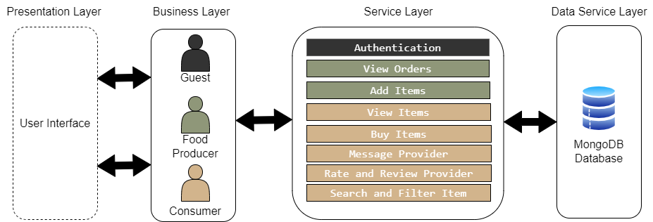
System Design
Architecture diagram
Semester III
UQ21CA761B Project Work Phase II

Slide 22
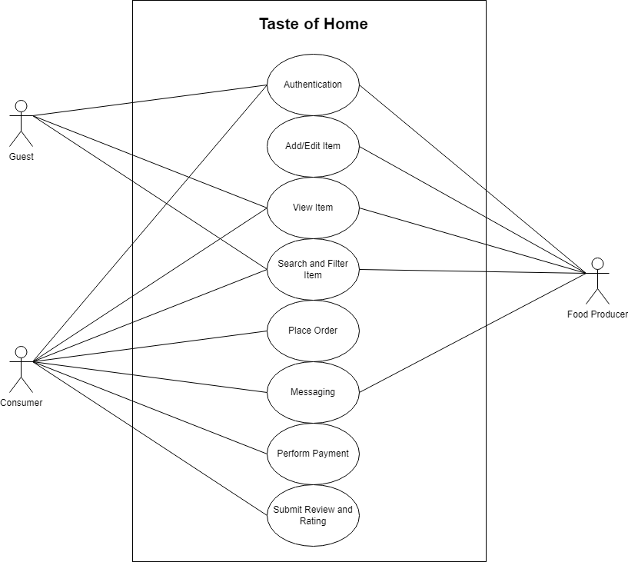
Detailed Design
Use case diagram
Semester III
UQ21CA761B Project Work Phase II

Slide 23
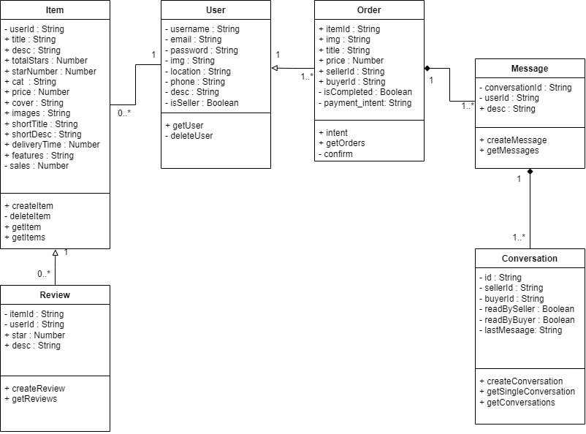
Detailed Design
Class Diagram
Semester III
UQ21CA761B Project Work Phase II

Slide 24
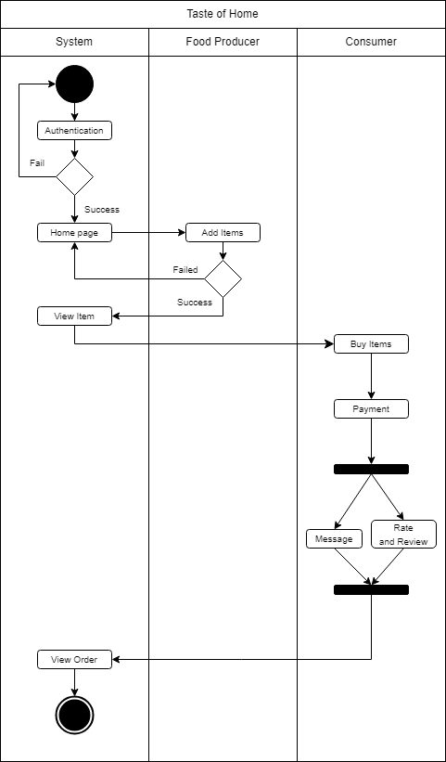
Detailed Design
Activity Diagram
Semester III
UQ21CA761B Project Work Phase II

Slide 25
Detailed Design
Document Structure
User
Username | String
Email | String
Password | String
Img | String
Location | String
Phone | String
Desc | String
isSeller | Boolean
Item
userId | String
Title | String
Desc | String
totalStars | Number
starNumber | Number
Cat | String
Price | Number
Cover | String
Images | String
shortTitle | String
shortDesc | String
deliveryTime | Number
Featrues | String
Sales | Number
Order
itemId | String
Img | String
Title | String
Price | String
sellerId | String
buyerId | String
isCompleted | Boolean
Payment_intent | String
Semester III
UQ21CA761B Project Work Phase II

Slide 26
Detailed Design
Document Structure
Review
itemId | String
userId | String
Star | Number
desc | String
Conversation
Id | String
sellerId | String
buyerId | String
readBySeller | Boolean
readByBuyer | Boolean
lastMessage | String
Message
conversationId | String
userId | String
desc | String
Semester III
UQ21CA761B Project Work Phase II

Slide 27
PSEUDO CODE
SIGN UP PAGE
If full username, email, password upload is empty then
Display error message “All fields are required”
If email or user is duplicate then
Display error message “User already exist”
Else
Save User details is saved to database
Display success message "User registered successfully!"
End
Semester III
UQ21CA761B Project Work Phase II

Slide 28
PSEUDO CODE
LOG IN PAGE
If username or password is empty then
Display error message “Username or password cannot be empty“
Else
If username and password match entries in database then
Display success message "User Login successfully!"
Else
Display error message "Invalid username or password"
Semester III
UQ21CA761B Project Work Phase II

Slide 29
PSEUDO CODE
HOME PAGE (Users)
If user is logged in then
Prompt user to:
I) View Items
II) View Orders
III) Buy Items
IV) Message Provider
V) Rate and Review Item
VI) Search and filter item
Semester III
UQ21CA761B Project Work Phase II

Slide 30
PSEUDO CODE
HOME PAGE (Food Producer)
If user is logged in then
Prompt user to:
I) View Items
II) Add Items
III) View Orders
IV) Buy Items
V) Message Provider
VI) Rate and Review Item
VII) Search and filter item
Semester III
UQ21CA761B Project Work Phase II

Slide 31
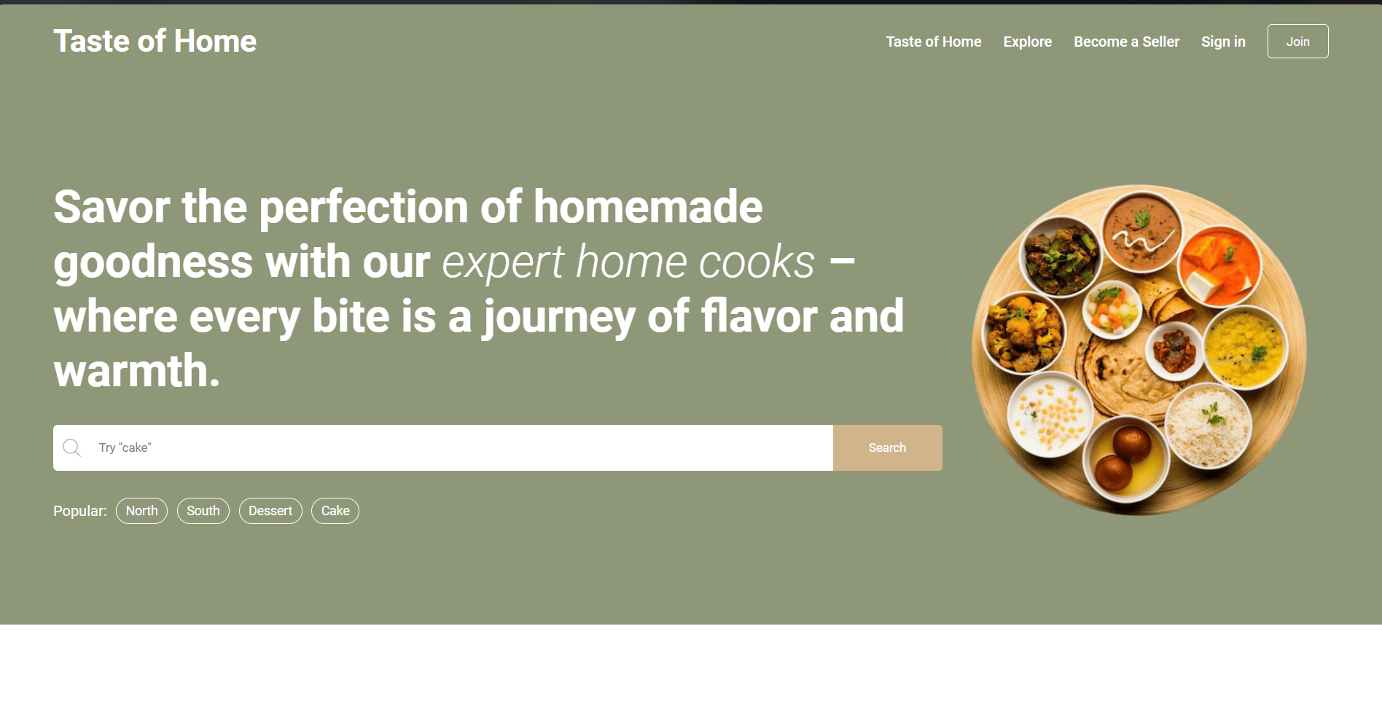
IMPLEMENTATION
SCREENSHOTS
Semester III
UQ21CA761B Project Work Phase II

Slide 32
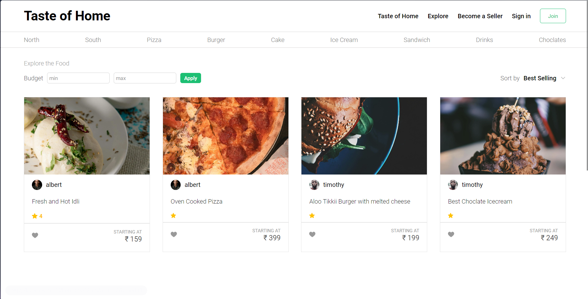
IMPLEMENTATION
SCREENSHOTS
Semester III
UQ21CA761B Project Work Phase II

Slide 33
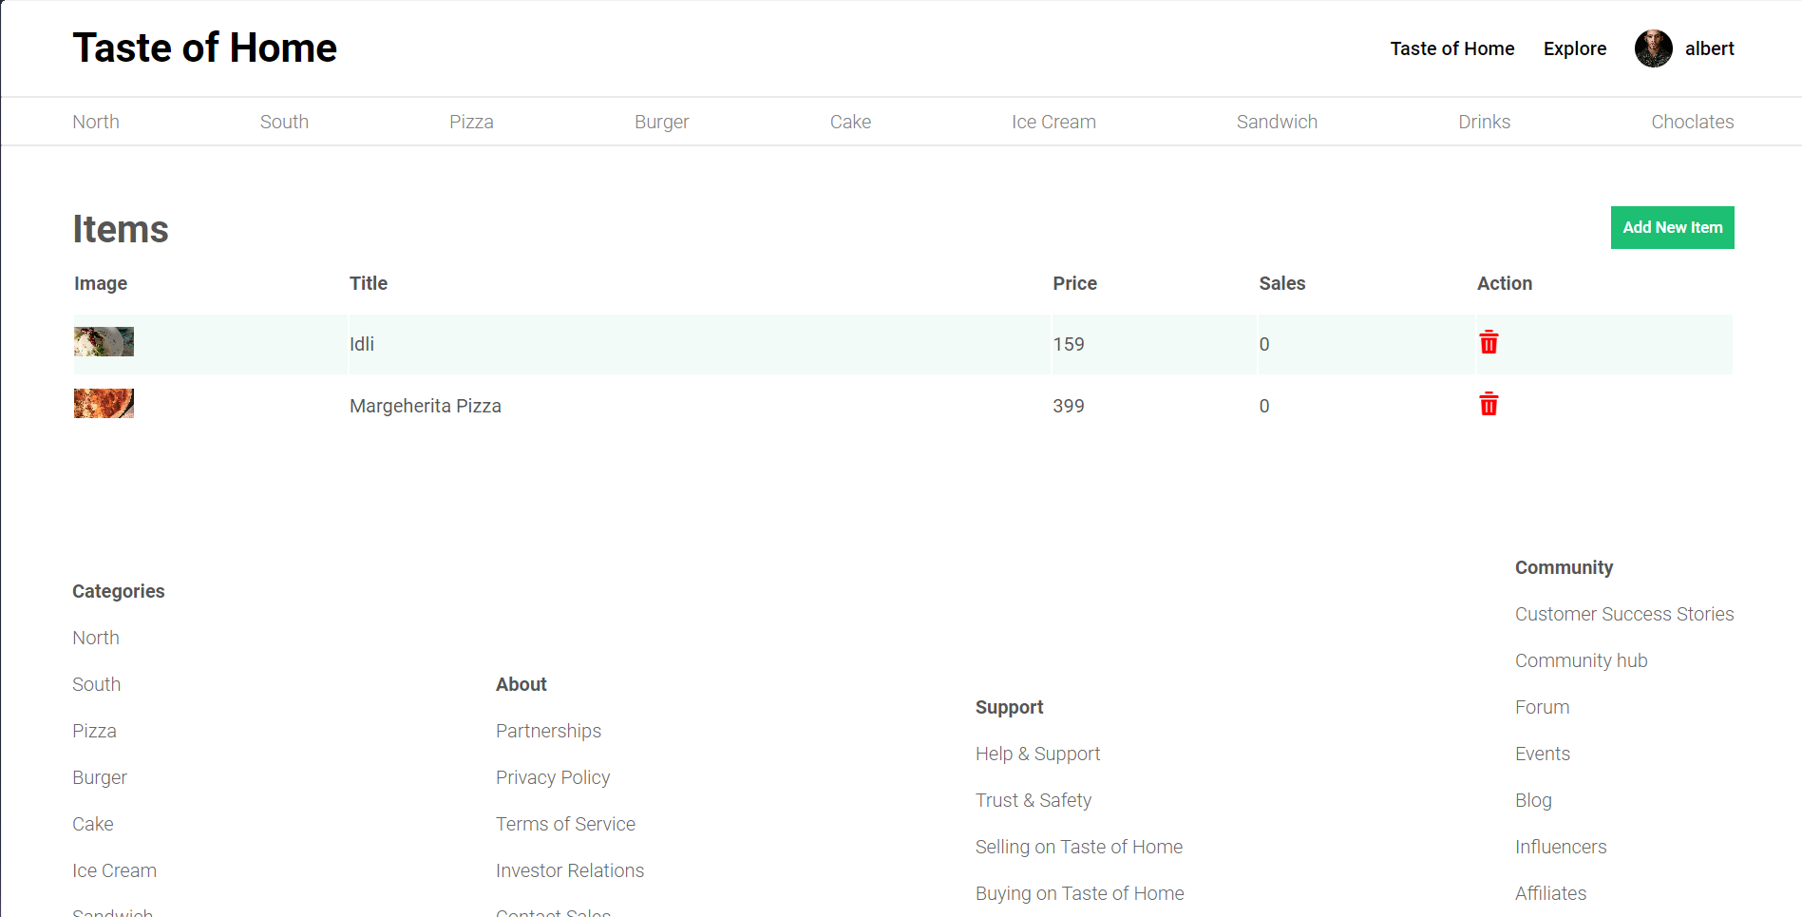
IMPLEMENTATION
SCREENSHOTS
Semester III
UQ21CA761B Project Work Phase II

Slide 34
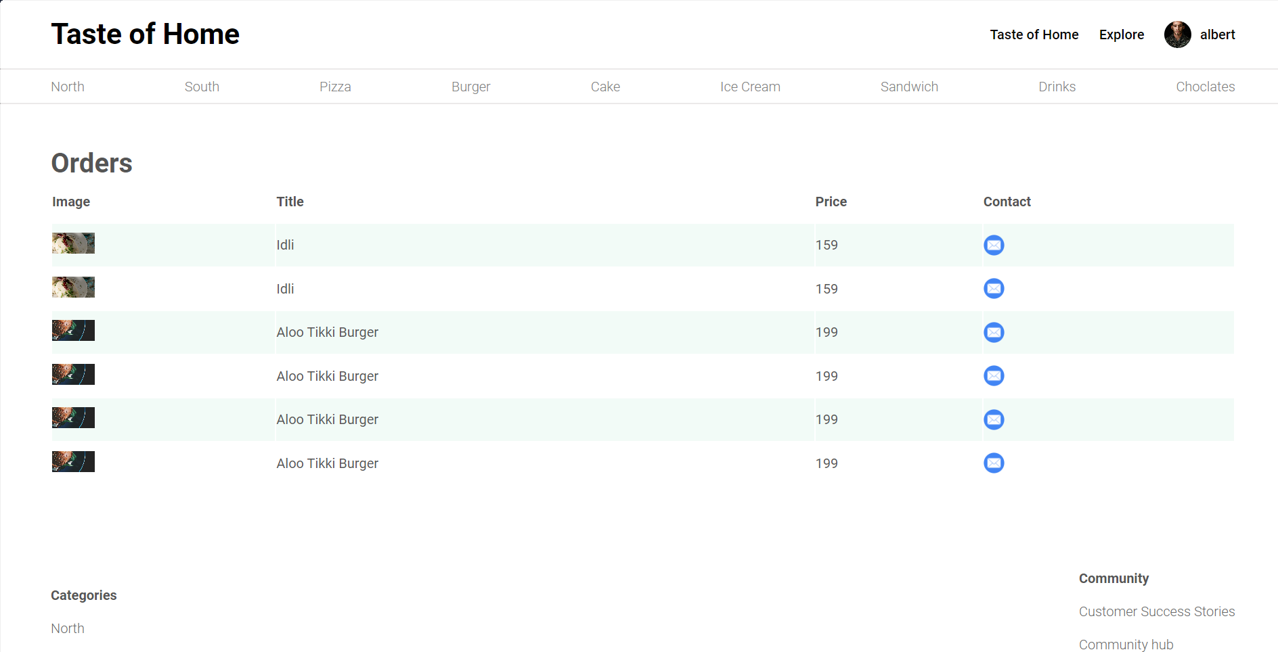
IMPLEMENTATION
SCREENSHOTS
Semester III
UQ21CA761B Project Work Phase II

Slide 35
IMPLEMENTATION
SCREENSHOTS
Semester III
UQ21CA761B Project Work Phase II

Slide 36
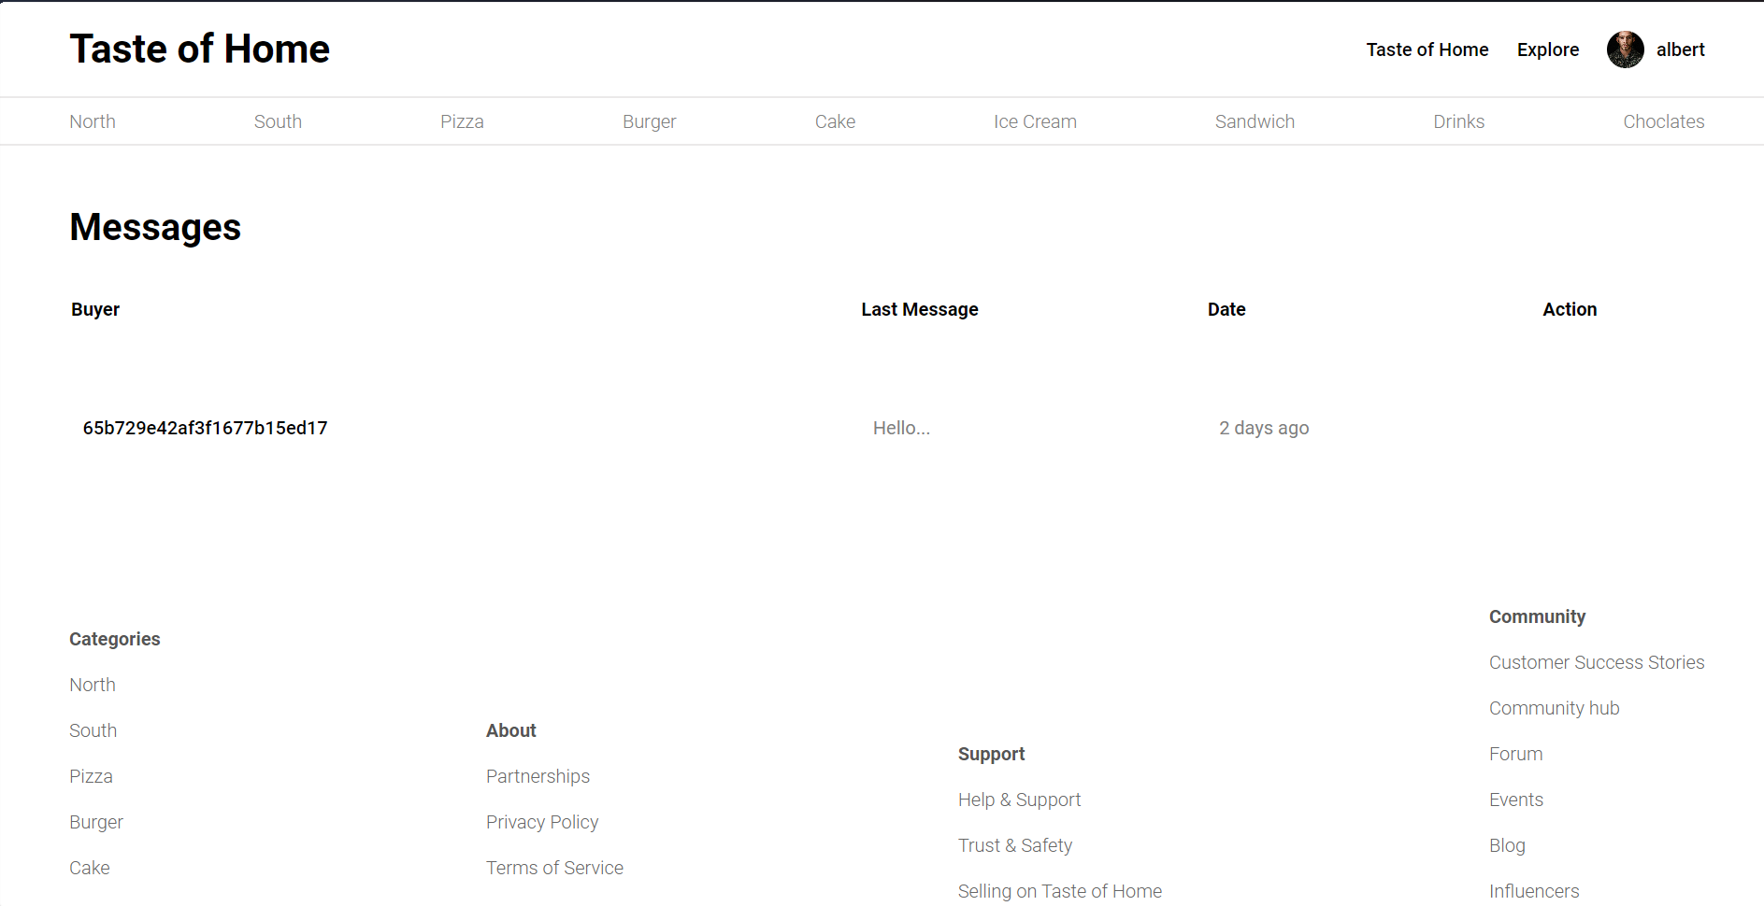
IMPLEMENTATION
SCREENSHOTS
Semester III
UQ21CA761B Project Work Phase II

Slide 37
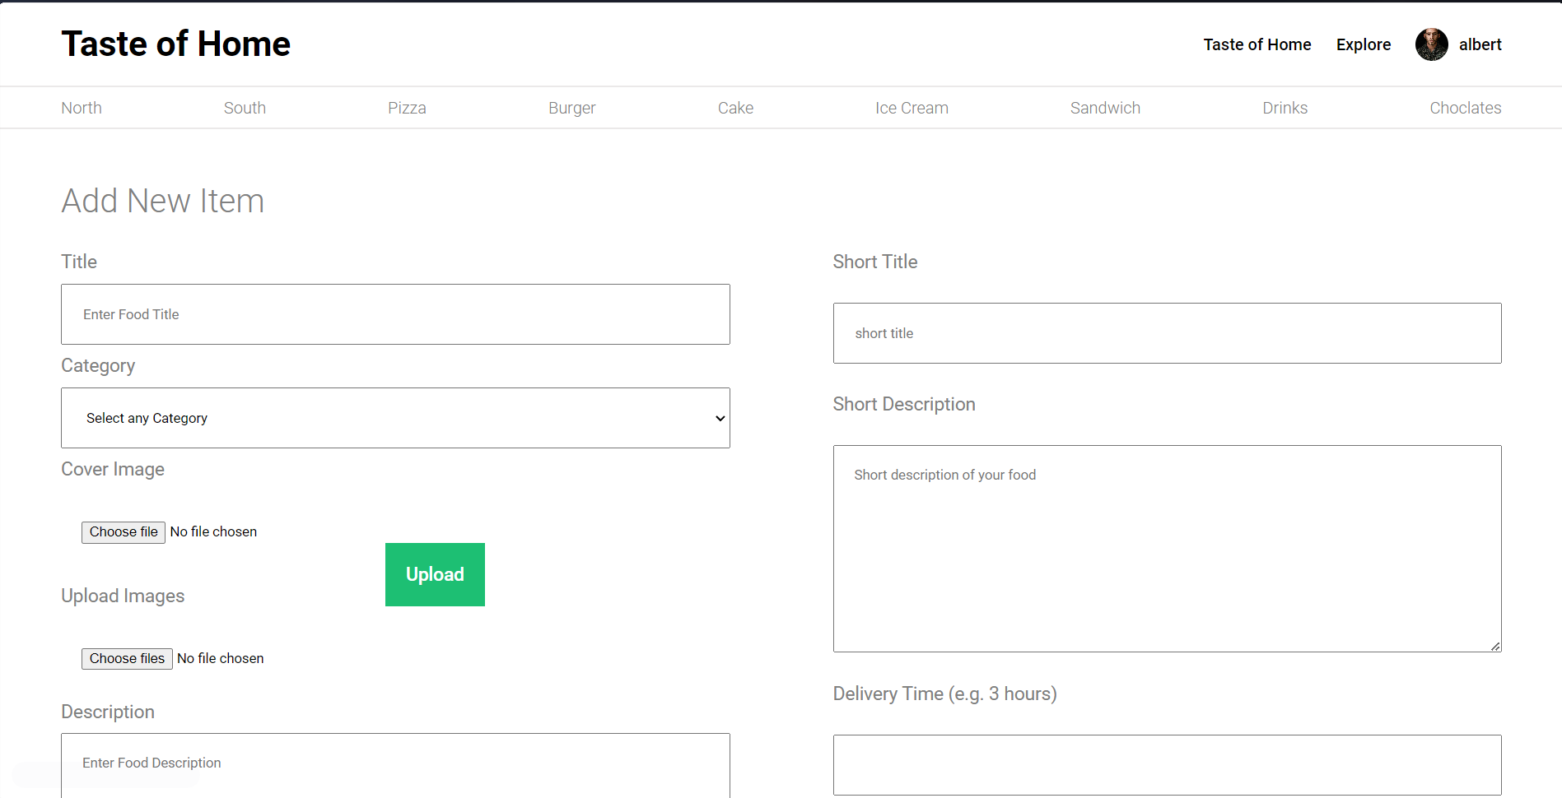
IMPLEMENTATION
SCREENSHOTS
Semester III
UQ21CA761B Project Work Phase II

Slide 38
SOFTWARE TESTING
TEST CASES
Test Scenario | Registration
Test Case ID | Step Details | Expected Result | Actual Result | Pass/Fail/Non Executed/Suspended
TC01 | valid username and password | Successful account creation | Successful account creation | Pass
TC02 | Empty /Invalid Email | Error message | Error message | Fail
TC03 | Empty /Invalid Password | Error message | Error message | Fail
Semester III
UQ21CA761B Project Work Phase II

Slide 39
SOFTWARE TESTING
TEST CASES
Test Scenario | Login
Test Case ID | Step Details | Expected Result | Actual Result | Pass/Fail/Non Executed/Suspended
TC04 | Valid Email id/Password | Successful log-in and redirection to the home page | Successful log-in and redirection to the home page | Pass
TCO5 | Invalid Email/Password | Error Message | Error Message | Fail
Semester III
UQ21CA761B Project Work Phase II

Slide 40
SOFTWARE TESTING
TEST CASES
Test Scenario | Payment
Test Case ID | Step Details | Expected Result | Actual Result | Pass/Fail/Non Executed/Suspended
TC06 | Valid name,email,card number,expiry date and cvv | payment processed, order placed | payment processed, order placed | Pass
TC07 | Leave one or more fields blank | Error message | Error message | Fail
TC08 | Invalid Card number | Error message | Error message | Fail
TC09 | Expired card expiry date | Error message | Error message | Fail
Semester III
UQ21CA761B Project Work Phase II

Slide 41
SOFTWARE TESTING
TEST CASES
Test Scenario | Item Change
Test Scenario | Step Details | Expected Result | Actual Result | Pass/Fail
TC11 | Update Item Details | Details Updated successfully | Details Updated successfully | Pass
TC12 | Delete Item | Item deleted | Item deleted | Pass
TC13 | Add new Item | Item added successfully | Item added successfully | Pass
Semester III
UQ21CA761B Project Work Phase II

Slide 42
CONCLUSION
TEST CASES
Taste of Home represents a groundbreaking initiative that harnesses technology to redefine the culinary landscape. By seamlessly connecting local food producers with consumers through its innovative MERN stack platform, it has successfully nurtured a vibrant community centered around culinary passion and expertise. Comprehensive user profiles, detailed listings, integrated messaging systems, secure payment gateways, and robust review mechanisms collectively foster transparency, trust, and personalized interactions. However, Taste of Home's impact transcends mere technological prowess – it embodies a profound commitment to champion local talents, combat food waste, promote sustainability, and contribute to the growth of local economies. Through nurturing strong community connections and enabling the celebration of homemade culinary delights, Taste of Home envisions a future where authentic flavors enrich lives and redefine the way we experience food.
Semester III
UQ21CA761B Project Work Phase II

Slide 43
Future Enhancement
TEST CASES
Taste of Home aims to continuously evolve and expand its impact, driven by a steadfast commitment to innovation and sustainability. Leveraging advanced data analytics and machine learning techniques, the platform could introduce personalized recommendations tailored to individual preferences, dietary requirements, and local food trends. This would further streamline the discovery process, ensuring a curated and delightful experience for consumers while maximizing exposure for local producers. Additionally, the integration of cutting-edge technologies could revolutionize the user experience:
• Virtual and augmented reality for immersive visual explorations of offerings
• AI-powered chatbots for seamless communication and query resolution
• Blockchain integration for enhanced transparency and traceability
Taste of Home also recognizes the immense potential of fostering a collaborative ecosystem, where producers can share best practices, techniques, and resources, fostering a supportive community of culinary excellence. By embracing emerging technologies and fostering collaboration, Taste of Home is poised to solidify its position as a trailblazer, driving positive change in the culinary industry while promoting sustainable practices and nurturing a deep appreciation for the art of homemade cuisine.
Semester III
UQ21CA761B Project Work Phase II

Slide 44
Application in Real World
0 level DFD
In the real world, Taste of Home provides a platform for discovering and sharing authentic homemade food, bringing the comfort of home-cooked meals to users.
It contribute to a more sustainable and localized food supply chain, promoting environmental responsibility and reducing the carbon footprint associated with food production and distribution.
Semester III
UQ21CA761B Project Work Phase II

Slide 45
Detailed Design
References
[1] A REAL TIME WEB SERVICE SYSTEM FOR FOOD DELIVERY | Journal of Data Acquisition and Processing | 2023 | https://sjcjycl.cn/article/view-2023/pdf/02_1628.pdf
[2] Causal analysis of factors contributing to food wastage in restaurants of India | International Conference on Computational Intelligence and Sustainable Engineering Solutions (CISES) | 2023-12-27 | https://ieeexplore.ieee.org/document/10183615
[3] Food Ordering website "Cooked with care" developed using MERN stack | IEEE Xplore | 2022 | https://www.researchgate.net/publication/361178168_Food_Ordering_website_Cooked_with_care_developed_using_MERN_stack
[4] Web Based Application for Ordering Food Raw Materials | 1st International Conference on Computer Science and Artificial Intelligence | 2021 | https://ieeexplore.ieee.org/document/9609733
[5] Design of Web App for Online Food Services | International Journal for Research in Applied Science & Engineering Technology (IJRASET) | May 2022 | https://www.ijraset.com/research-paper/design-of-web-app-for-online-food-services
Semester III
UQ21CA761B Project Work Phase II

Slide 46
Detailed Design
References
[6] E-Commerce web Application by using MERN Technology | International Journal for Modern Trends in Science and Technology | June 2021| https://www.ijmtst.com/vol7issue05.html
[7] MERN Stack Web Development | Annals of R.S.C.B | May 2021 | http://annalsofrscb.ro/index.php/journal
[8] CHALLENGES OF FOOD SECURITY | International Conference on Research in Humanities, Applied Sciences and Education| June 5th 2022| https://www.researchgate.net/publication/312093853_Challenges_of_Food_Security_in_India
[9] Investigating the Feasibility of a Restaurant Delivery Service to Improve Food Security among College Students Experiencing Marginal Food Security, a Head-to-Head Trial with Grocery Store Gift Cards | Int. J. Environ. Res. Public Health | 2021 | https://doi.org/10.3390/ijerph18189680
[10] Implementation of RESTful API Web Services Architecture in Takeaway Application Development | 1st International Conference on Electronic and Electrical Engineering and Intelligent System (ICE3IS)| 2021 | https://ieeexplore.ieee.org/document/9649679
Semester III
UQ21CA761B Project Work Phase II

Slide 47
Detailed Design
References
[11] Solving Food Wastage issues through BYOD application | Fifth National Conference of Saudi Computers Colleges (NCCC) | 2022 | https://ieeexplore.ieee.org/document/10067735
[12] Review of Online Food Delivery Platforms and their Impacts on Sustainability | Fifth National Conference of Saudi Computers Colleges (NCCC) | 8 July 2020| https://ideas.repec.org/a/gam/jsusta/v12y2020i14p5528-d382021.html
Semester III
UQ21CA761B Project Work Phase II

Slide 48
Thank You !!
Semester III
UQ21CA761B Project Work Phase II

